Slide 1





Adoptable Pets
Exploratory Data Analysis of Shelter Animals
Jismi Mathew - CMP-262-86511

Slide 2

Introduction
Purpose:
identify trends that impact shelter operations
Questions being explored:
What types of animals are most common in the shelter?
Does pet size vary by animal type?
What is the age distribution of animals in the shelter?
Does animal age vary by animal type?

Slide 3

Methodology
Dataset: Adoptable Pets
Source: Data.gov
Format: CSV file
Total: 77 animal records
Unit of analysis: individual animal
Key features: Animal type, Size, Age, Intake date
Tools used: Jupyter Notebook (Python), Pandas, Matplotlib & Seaborn

Slide 4
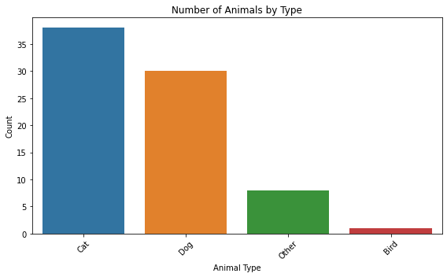

Results - Q1
Cats and dogs make up the majority of animals
Cats appear slightly more often than dogs
Birds and other animals are rare

Slide 5

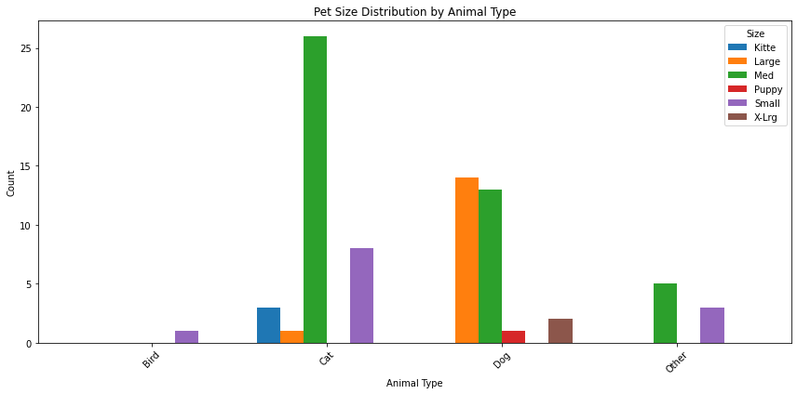
Results - Q2
Dogs show the widest range of sizes
Cats are mostly small to medium
Other animals are almost entirely small or medium

Slide 6
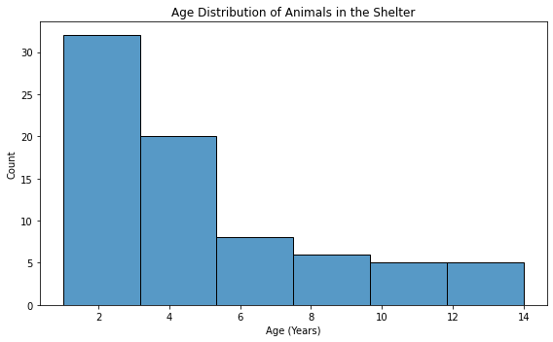

Results - Q3
Most animals are between 1–4 years old
Peak around ages 2–3
Very few senior animals

Slide 7
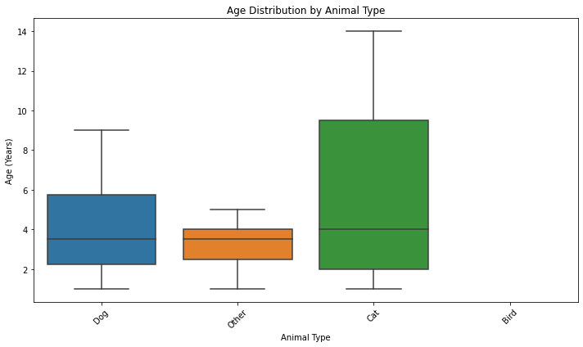

Results - Q4
Cats show the widest age range
Dogs are more consistently young to middle-aged
Fewer data points for birds and other animals

Slide 8

Future Work
Analyze adoption outcomes and length of stay
Explore breed-level adoption trends
Include larger or multi-shelter datasets

Slide 9


Questions?
Thank you!

Slide 10
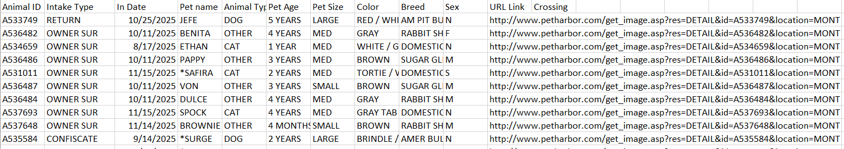
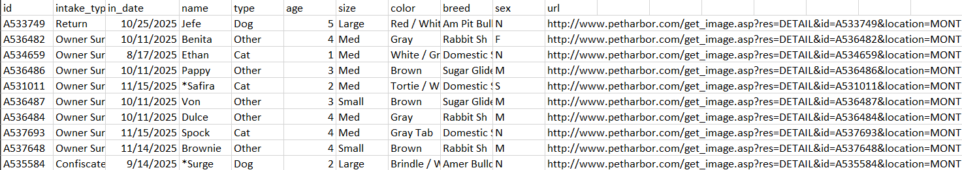
Appendix
Original Dataset
Cleaned Dataset – got rid of crossing column which was filled with NA values, converted age to int, cleaned names and values, etc.
Dataset link: https://catalog.data.gov/dataset/adoptable-pets

